Slide 1


Did you Learn Something New?
ⓘ Start presenting to display the poll results on this slide.
Notes:
📣 This is Slido interaction slide, please don't delete it. ✅ Click on 'Present with Slido' and the poll will launch automatically when you get to this slide.
Something new you learned from module/week 1

Slide 2
Intro to ML
UTMIST Study Group - Module 1
Notes:
Welcome to our study group’s first formal meeting

Slide 3
Topics
Linear regression & classification
Loss functions
Activation functions
Gradient descent
Overfitting & regularization
Notes:
Topics covered in module 1’s content

Slide 4

Linear Regression & Classification Examples
ⓘ Start presenting to display the poll results on this slide.
Notes:
📣 This is Slido interaction slide, please don't delete it. ✅ Click on 'Present with Slido' and the poll will launch automatically when you get to this slide.
List examples of where they’re applied

Slide 5
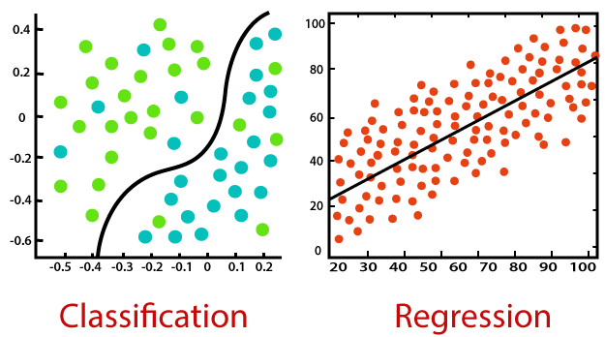
Linear Regression vs Classification
https://static.javatpoint.com/tutorial/machine-learning/images/regression-vs-classification-in-machine-learning.png
Notes:
Differences
Classification: cat or dog
Regression: house price vs size

Slide 6
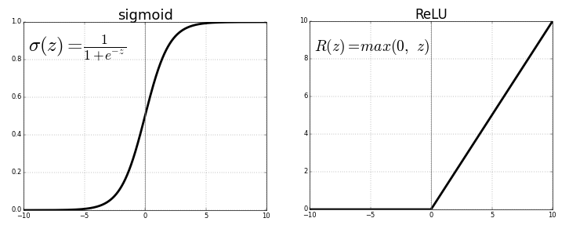
Activation Functions
How are activation functions useful?
Difference between linear and non-linear activation functions?
Various types and their uses?
https://miro.medium.com/max/1750/1*XxxiA0jJvPrHEJHD4z893g.png
Notes:
BOR of 3 people for ~5min
Map result to specific ranges
Sigmoid: 0-1 probability
ReLu: most used, model easier to train and better performance
Github additional resources has link on more details

Slide 7
Different Types of Loss Functions
ⓘ Start presenting to display the poll results on this slide.
Notes:
📣 This is Slido interaction slide, please don't delete it. ✅ Click on 'Present with Slido' and the poll will launch automatically when you get to this slide.
Evaluate accuracy prediction
Different types of loss functions

Slide 8
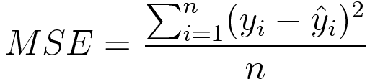
Loss Functions
Mean Squared Error (MSE) Loss
Regression loss
Average of squared difference
Penalize wrong predictions that were further away
Cross Entropy Loss
Classification loss
Penalize wrong predictions that were confident
https://towardsdatascience.com/common-loss-functions-in-machine-learning-46af0ffc4d23
Notes:
Common ones and their uses

Slide 9
Optimization Algorithms
In breakout room groups, try to recall these terms:
Optimization algorithm
Gradient
Gradient descent
Learning rate
Stochastic gradient descent
Notes:
BOR of 3 people for ~5min

Slide 10
Optimization Algorithms
Optimization algorithm: function’s min/max
Gradient: direction of steepest ascent
Gradient descent: first-order (first derivative)
Learning rate: size of step in each iteration
Stochastic gradient descent: randomly select data point to represent
Notes:
Refer to the image in the next slide

Slide 11
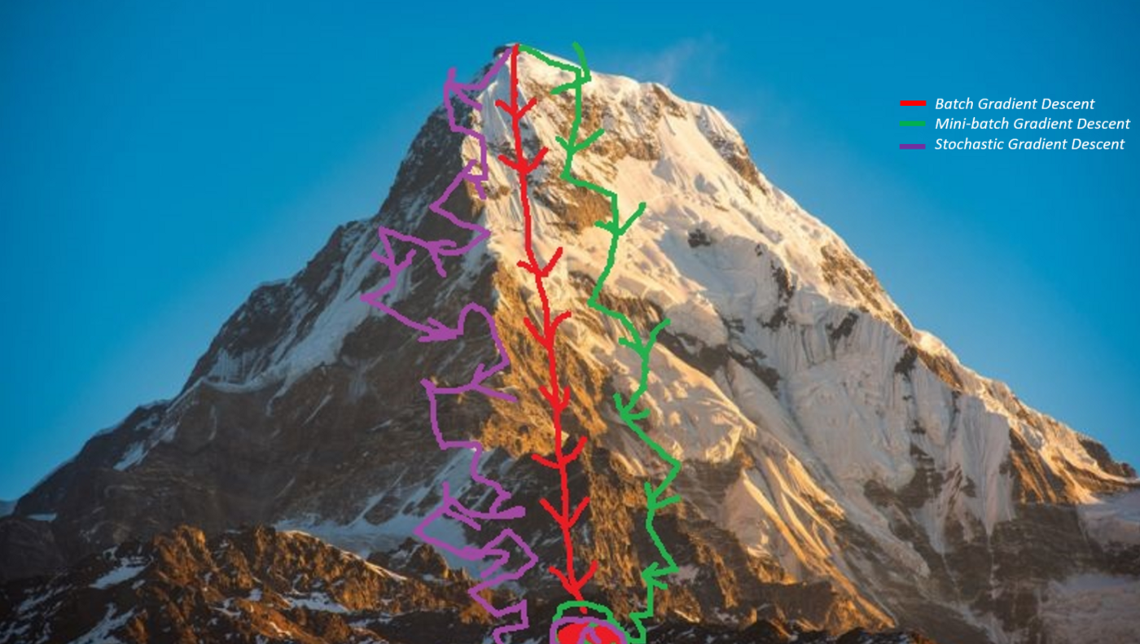
Gradient Descent
https://miro.medium.com/max/1400/1*70f9PB-RwFaakqD6lfp4iw.png

Slide 12
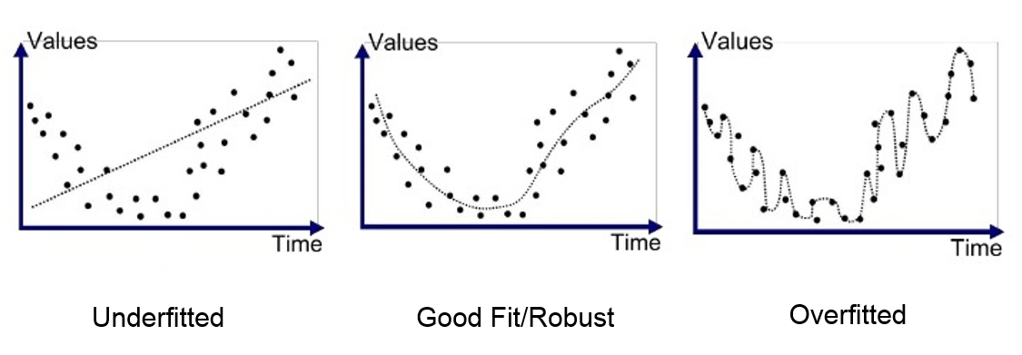
Regularization
Discourage learning complex model
Avoid overfitting
https://medium.com/greyatom/what-is-underfitting-and-overfitting-in-machine-learning-and-how-to-deal-with-it-6803a989c76

Slide 13

Thank You!
We welcome any questions/feedback.
Feedback Form: https://forms.gle/BSokDwZGSocJ2J2o8
Notes:
*Get specific feedback on pacing & difficulty - Poll on Zoom*
Would appreciate feedback/suggestions on discussion format

